Slide 1
Webinar Indiana Health Sciences Librarians Association Systematic Searching : Improving Effectiveness and Efficiency
17 September 2021
Wichor Bramer
Erasmus MC – Rotterdam, the Netherlands
Twitter: @wichor

Slide 2
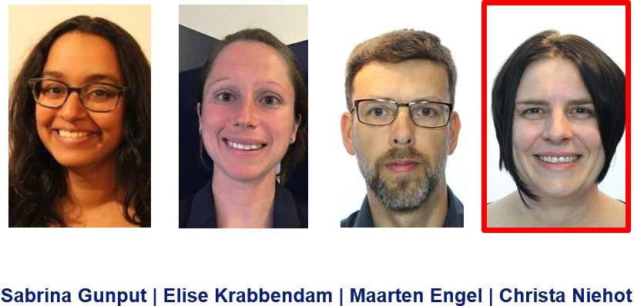
My background
Bachelor Biology (1998)
Bachelor Information Services and Management (2002)
Information Specialist Erasmus MC University Medical Center Rotterdam, the Netherlands (2009-present)
PhD thesis “Serving Evidence Syntheses” (2019)

Slide 3
A new method of searching
Bramer WM, de Jonge GB, Rethlefsen ML, Mast F, Kleijnen J. A systematic approach to searching: an efficient and complete method to develop literature searches. J Med Libr Assoc. 2018 Oct;106(4):531-41.

Slide 4
Analyzing research question
Watch out for bias:
Specific characteristics →Duration of breastfeeding and intelligence
Judgement →Poor family functioning, harsh parenting and bullying behavior of children/adolescent
Watch out for duplicates:
Pre-eclampsia AND pregnant AND women
Lichtenstein therapy AND inguinal hernias
Notes:
4

Slide 5
Analyzing research question: Does eating broccoli help in the prevention of cancer?
broccoli
prevention
cancer
specific
general
important
brassica
vegetables
cancer
Go to menti.com and use the code 3474 2624
broccoli
prevention
unimportant
Which elements would you use?

Slide 6
Finding Search terms
Kidney Dialysis

Slide 7
Selecting the first database
What is your first database of choice?
Medline (PubMed or Ovid) or Embase?
Go to www.menti.com and use the code 3474 2624

Slide 8
Recommended starting database/ interface
Embase.com
Embase via Ovid
Medline via Ovid
Medline via other interface (EBSCOhost/ ProQuest etc.)
PubMed

Slide 9
Generating search strategy
Embase.com
Titel/abstract ():ab,ti ⁽*⁾
Thesaurus terms ⁽**⁾ /exp
Proximity (() NEAR/3 ())
(Truncated) Phrases always-use-a-hyphen*
⁽*⁾ Only once per element
⁽**⁾ After each term
⁽***⁾ Proximity not available
Ovid
().ab,ti. ⁽*⁾
exp … /
(() ADJ3 ())
PubMed
[tiab] ⁽**⁾
[mesh]
(() AND ()) ⁽***⁾
Go to www.menti.com and use the code 3474 2624
DEMO

Slide 10
Important advice:
Create and adapt search in word, never in the interface
Create Single Line Search Strategies (can be very long)

Slide 11
Line by line searches or single line search?
Well structured?
#1 brassica [mh]
#2 brassica* [tiab]
#3 broccoli [tiab]
#4 #1 OR #2 OR #3
#5 neoplasms [mh]
#6 neoplas* [tiab]
#7 cancer* [tiab]
#8 tumor* [tiab]
#9 #5 OR #6 OR #7 OR #8
#10 #4 AND #9
#11 animals[mh]
#12 humans[mh]
#13 #11 NOT #12
#14 #11 NOT #13
#15 #10 NOT #14
Unstructured?
(brassica [mh] OR brassica* [tiab] OR broccoli [tiab]) AND (neoplasms [mh] OR neoplas* [tiab] OR cancer* [tiab] OR tumor* [tiab]) NOT (animals[mh] NOT humans [mh])

Slide 12
Line by line searches or single line search?
Unstructured!
#1 brassica [mh]
#2 brassica* [tiab]
#3 broccoli [tiab]
#4 #1 OR #2 OR #3
#5 neoplasms [mh]
#6 neoplas* [tiab]
#7 cancer* [tiab]
#8 tumor* [tiab]
#9 #5 OR #6 OR #7 OR #8
#10 #4 AND #9
#11 animals[mh]
#12 humans[mh]
#13 #11 AND #12
#14 #11 NOT #13
#15 #10 NOT #14
#16 Cauliflower*[tiab]
#17 #1 OR #2 OR #3 OR #16
#18 #17 AND #9
#19 #18 NOT #14
(#20 #19 NOT #15)
Well structured!
(brassica [mh] OR brassica* [tiab] OR broccoli [tiab] OR cauliflower*[tiab]) AND (neoplasms [mh] OR neoplas* [tiab] OR cancer* [tiab] OR tumor* [tiab]) NOT (animals[mh] NOT humans [mh])

Slide 13
Important advice:
Create and adapt search in word, never in the interface
Create Single Line Search Strategies (can be very long)
Type syntax before copying and pasting terms
Carefully position cursor with arrow buttons
Use Ctrl-V to paste, set standard paste to unformatted
Prepare proximity in advance
Use hyphens instead of quotes

Slide 14
Questions and remarks?

Slide 15
Evaluating the search strategy

Slide 16
Too few results?
Too many results?
Add extra terms
OR study type
16
Notes:
16

Slide 17
Which articles can answer your question?
Facilitators and barriers in preconception care
Evaluation studies of preconception care
(Preconception Care[mh] OR Preconception-Care*[tiab]) AND (Facilitator*[tiab] OR barrier*[tiab])
→ 116 results
(Preconception Care[mh] OR Preconception-Care*[tiab]) AND (Facilitator*[tiab] OR barrier*[tiab] OR Evaluation Study [Publication Type] OR Evaluation*[tiab])
→ 279 results
Notes:
17

Slide 18
Too few results?
Too many results?
Add extra terms
OR study type
OR broad filter
Generalize specific elements
Drop less important elements
2 elements → 1 element (A) AND (B) → (A OR B)
Use broader thesaurus terms
Remove general synonyms
Specify general elements
Add an extra element
AND study type
AND narrow filter
1 element → 2 elements (A OR B) → (A) AND (B)
Do not explode
Combine subheadings with MeSH
Add Filters for date or language?
Search major thesaurus terms and title (for systematic reviews?)
18
Notes:
18

Slide 19
Major and title in an SR search?
Exercise therapy for Hip Osteoarthritis
(Osteoarthritis, Hip[mh] OR Hip-Osteoarth*[tiab]) AND (Exercise Therapy[mh] OR Exercise-Therap*[tiab])
367 results
(Osteoarthritis, Hip[mh] OR Hip-Osteoarth*[tiab] OR Osteoarthritis[mh] OR Osteoarthrit*[tiab]) AND (Exercise Therapy[mh] OR Exercise-Therap*[tiab])
2054
(Osteoarthritis, Hip[mh] OR Hip-Osteoarth*[tiab] OR Osteoarthritis[mj] OR Osteoarthrit*[ti]) AND (Exercise Therapy[mh] OR Exercise-Therap*[tiab])
→1673

Slide 20
Too few results?
Too many results?
Add extra terms
OR study type
OR broad filter
Generalize specific elements
Drop less important elements
2 elements → 1 element (A) AND (B) → (A OR B)
Use broader thesaurus terms
OR major terms OR terms in title
Using NOT for SRs?
Remove general synonyms
Specify general elements
Add an extra element
AND study type
AND narrow filter
1 element → 2 elements (A OR B) → (A) AND (B)
Do not explode
Combine subheadings with MeSH
Add Filters for date or language?
Search major thesaurus terms and title with AND
Remove noise by using NOT
20
Notes:
20

Slide 21
Safe use of NOT
NOT out a very specific element:
NOT (neoplasms/therapy[mj] OR cancer-therap*[ti])
NOT out noise only on a specific term:
… hiv OR (aids NOT hearing-aids) OR …
Or use a double NOT:
NOT (animals[mh] NOT humans[mh])
NOT (child[mh] NOT adult[mh])

Slide 22
Use a double NOT
AND (heart ventricles[mh] NOT (left-ventric*[tiab] NOT right-ventric*[tiab]))
left-ventric*
[tiab]
right-ventric*
[tiab]
heart ventricles[mh]

Slide 23
Translating the search strategy
Which databases are most important for an SR search?
Go to www.menti.com and use the code 3474 2624

Slide 24
When to use what databases?
Bramer WM, Rethlefsen ML, Kleijnen J, Franco OH. Optimal database combinations for literature searches in systematic reviews: a prospective exploratory study. Syst Rev. 2017 Dec 6;6(1):245.

Slide 25
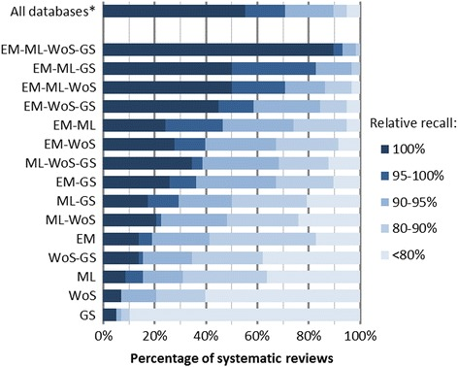

Slide 26
Translating the search strategy
bit.ly/databasemacros

Slide 27
Translating the search strategy
Embase.com (Embase and Medline)
Thorough optimization of thesaurus terms and title / abstract terms in search strategy
Macro and edit thesaurus
Add extra terms
Remove thesaurus
Macro and edit
Medline (Ovid incl ePub)
MeSH terms in PubMed / Optimization
Cochrane library
Google Scholar
Macro
edit thesaurus
Macro and edit thesaurus
Web of Science
Liliacs / Scielo / Trial Registers / WorldCat etc.
Basic search strategy with AND, OR parentheses
PsycINFO (OvidSP)
CINAHL (EBSCO)
Macro
Scopus

Slide 28
Does the method work?
Bramer WM, Rethlefsen ML, Mast F, Kleijnen J. Evaluation of a new method for librarian-mediated literature searches for systematic reviews. Res Synth Methods. 2018 Dec;9(4):510-20.
What is your current experience?
Go to www.menti.com and use the code 3474 2624

Slide 29
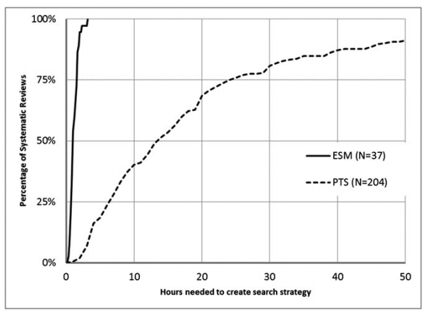
Time needed to create the searches

Slide 30
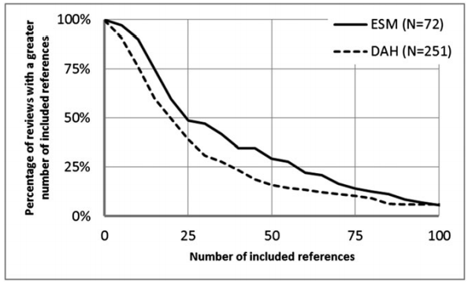
Sensitivity of the searches (included references)

Slide 31
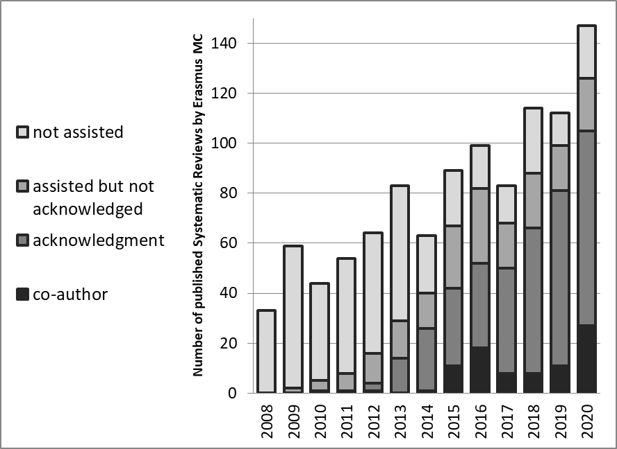
The effect for our institute

Slide 33
Success factors / Time savers
Single-line search strategies in Word
Direct feedback of researcher
Optimization techniques
Macros for syntax translation
Database order and interface choice
Second computer screen
Computer literacy (keyboard short cuts)
Educate researchers to accept higher numbers of references
Experience (be pro-active)

Slide 34
Effective Time Spending
Assume:
In a certain period, you have 20 hours of your time for search assistance
In that period you get 10 (serious) requests for assistance.
Question:
How many projects will you assist?
Go to www.menti.com and use the code 3474 2624

Slide 35
Peer review of searches
Medical Library as guardians for your institute’s scientific output!
Goal: Each SR search is seen by at least one librarian
Ideally: Develop all SR searches for your institute
Minimally: Peer review all SR searches by researchers from your institute
and educate researchers on how to do SR searches
Don’t rely on other institute’s librarians to peer review your SRs!
Never turn down a request for help. Not enough time? Ask your boss for more!

Slide 36
Want to learn more/ practice?
Workshops are scheduled for MLA annually
7 & 21 October (still a few places left)
My relevant publications:
bit.ly/wichorpubs

Slide 37
Thank you! Questions?
Twitter: @wichor
E-mail: w.bramer@erasmusmc.nl

