Slide 1
Using EndNote for
Librarian-Mediated
Systematic Review Searches
Wichor Bramer
Erasmus MC – Rotterdam, the Netherlands
25 January 2022
www.menti.com (7771 7276)
www.wichor.nl/20220125

Slide 2

My background
Bachelor Biology (1998)
Bachelor Information Services and Management (2002)
Information Specialist
Erasmus MC University Medical Center Rotterdam, the Netherlands
(2009-present)
PhD thesis
“Serving Evidence Syntheses” (2019)
including 4 chapters on EndNote for SRs

Slide 3
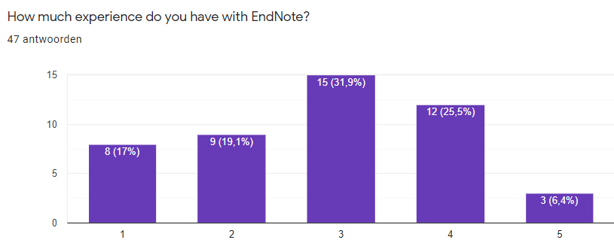
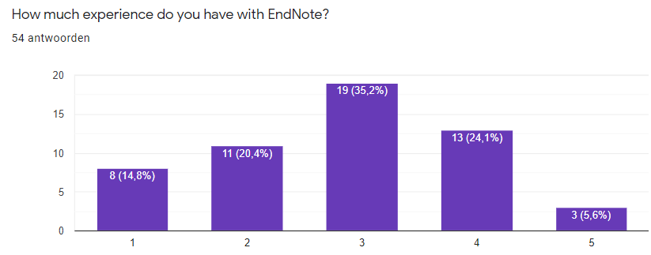
Who are you?
Beginner
Expert

Slide 4
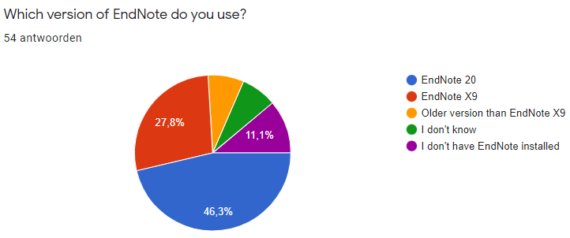
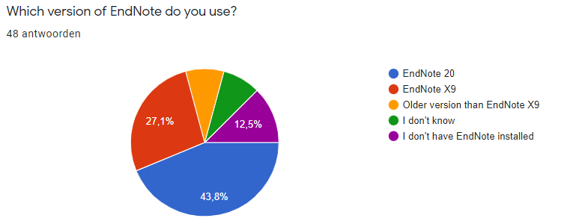

Slide 5
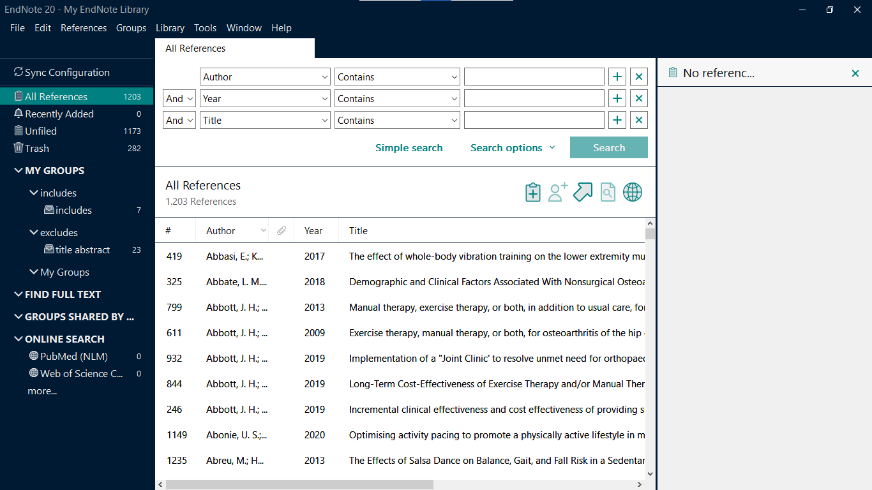
EndNote 20

Slide 6
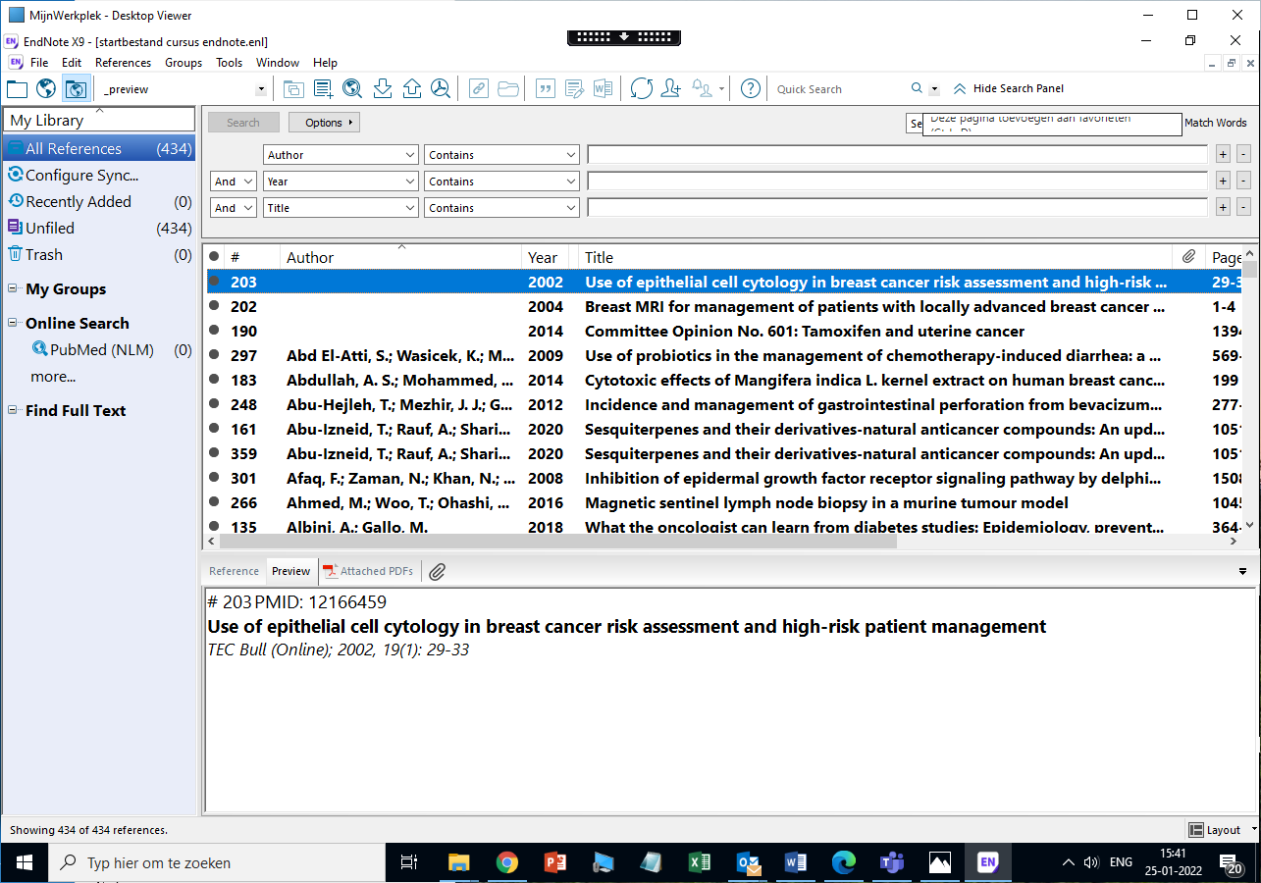
EndNote X9

Slide 7
Systematic Reviews | 21
Basic skills | 8
Import /export | 5
New version of EndNote | 4
Comparison with other software | 4
Deduplication | 4
EndNote web | 2
Updating existing searches | 1

Slide 8
EndNote vs other programs
menti.com
7771 7276
SR management software
Covidence
DistillerSR
Rayyan
(MS Excel or Word for screening?)
Reference Management software
Refworks
Mendeley
Zotero

Slide 9
Contents of the webinar (basic)
Let me know in menti.com what you want me to talk about
7771 7276
Basics of EndNote
Exporting from PubMed to EndNote
Exporting from other databases
Saving files / Recovering lost files
Find Full tekst
Basics of EndNote and Word
Insert citations
Selecting styles
Preventing Errors/ Repairing Errors
Full or abbreviated journal titles
Most frequent help desk issues

Slide 10
Saving Files/ Recovering lost Files
Watch out with the .enlx files.
Remove after opening (warn clients!)
If files are lost:
.Data folder is lost: Ask for backup
.enl file lost:
Create dummy file with correct name
(right click in explorer > File > New text document)

Slide 11
Helpdesk issues?
If you are EndNote helpdesk:
Ask your IT department for remote control features
EndNote not showing in Word?
Check File > Options > Add ins:
COM – Add ins / Disabled Add ins
Word document causing errors:
Turn off instant formatting
Convert to unformatted citations
Copy the text and paste in blank Word document

Slide 12
Two search methods
Searching PubMed in two ways
Searching via the PubMed website
Searching via the EndNote connect file
Two scenarios:
Doing research, finding relevant articles to read
Writing an article, adding references to your literature list
Which of these methods would you use in each of these scenarios?
Go to menti.com and use the code 7771 7276
12
Notes:
12

Slide 13
Contents of the webinar (expert)
Deduplication between multiple databases
Updating searches
Inclusion/ Exclusion for Systematic Reviews
Reference checking
Advanced tricks in Word (formatting SR table)
Adaptation of installation in our institute
Let me know in menti.com what you want me to talk about
7771 7276

Slide 14
Deduplication
Do you use other methods for deduplication?
How long does deduplication take?
Go to www.menti.com 7771 7276

Slide 15
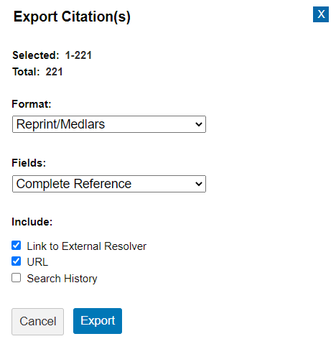
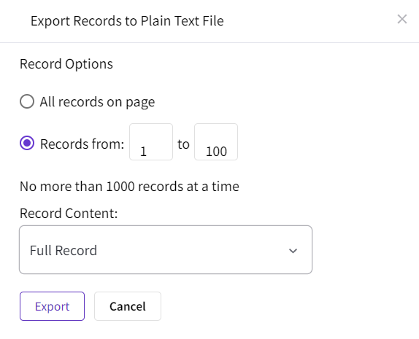
Deduplication
Change settings
  Display fields
  Custom filters/ Export formats
Import databases
  Import/ export/ Re-import medline records
  Use adapted filters (abbreviates journal titles)
Adapt field codes and remove duplicates
  Repeat these steps using the table

Slide 16
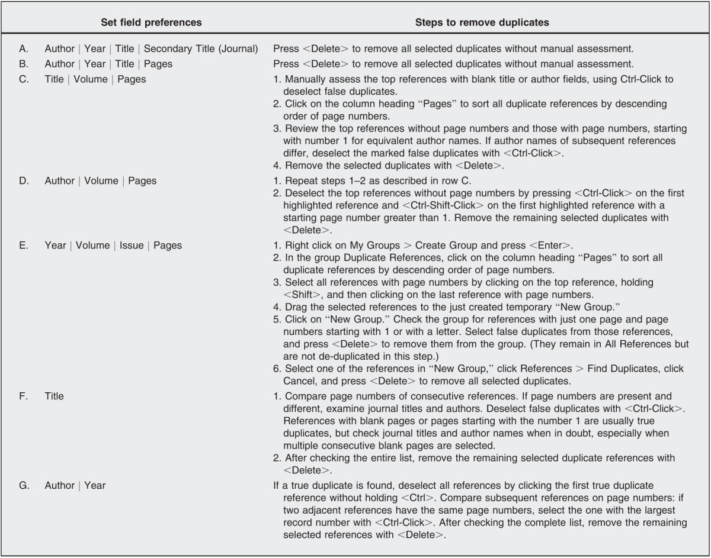

Slide 17
Adaptation of article
Instead of step E:
Copy Accession Numbers to fiel label
Deduplicate on Field label
first click Skip
then Cancel
remove all duplicates
(see the videos)

Slide 18
Updating searches
Traditional: Using date fields
Which fields do you use?
Which date do you use?

Slide 19
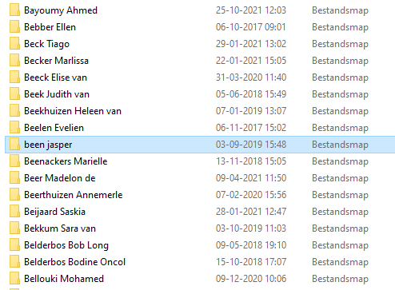

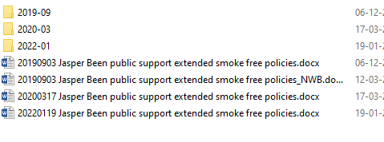
Storing client EndNote and search files

Slide 20
Updating searches
Download all results as normal
  Save the full results as enlx (for next update)
Deduplicate with the results from last time
  Remove both versions of duplicate articles
  Lastly remove old articles that were not retrieved now

Slide 21
Inclusion/ Exclusion
Which methods do you advise for inclusion/ exclusion?
How many references can be reviewed in an hour?
Go to www.menti.com 7771 7276

Slide 22
Inclusion/ Exclusion
Create groups for Inclusion / Exclusion
Reviewers drag references in these groups
Includes combined and deduplicated

Slide 23
Reference checking
Output format _scopus PMID generates a search in Scopus for relevant reviews and included references
Export the references of those articles or the references that cite these articles

Slide 24
Advanced tricks in Word
Formatting a table for SRs
Copy references from EndNote to word
with Ctrl-C – Ctrl-V
Replace (Ctrl-H)
; with @@author-year}^p{

Slide 25
Adaptation of installation (by IT)
Location and contents of help files
sharing custom made output styles
Reference type (esp Web Pages)

Slide 26
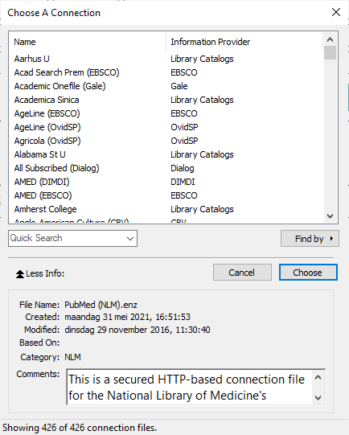
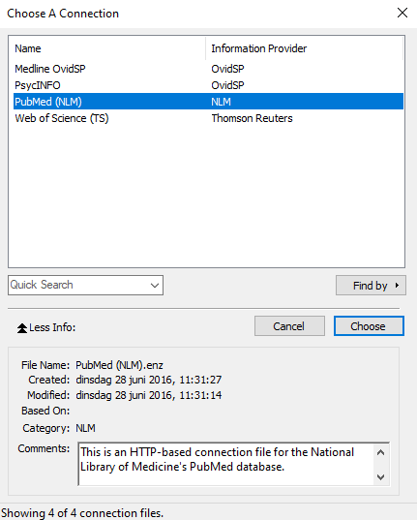

Slide 27
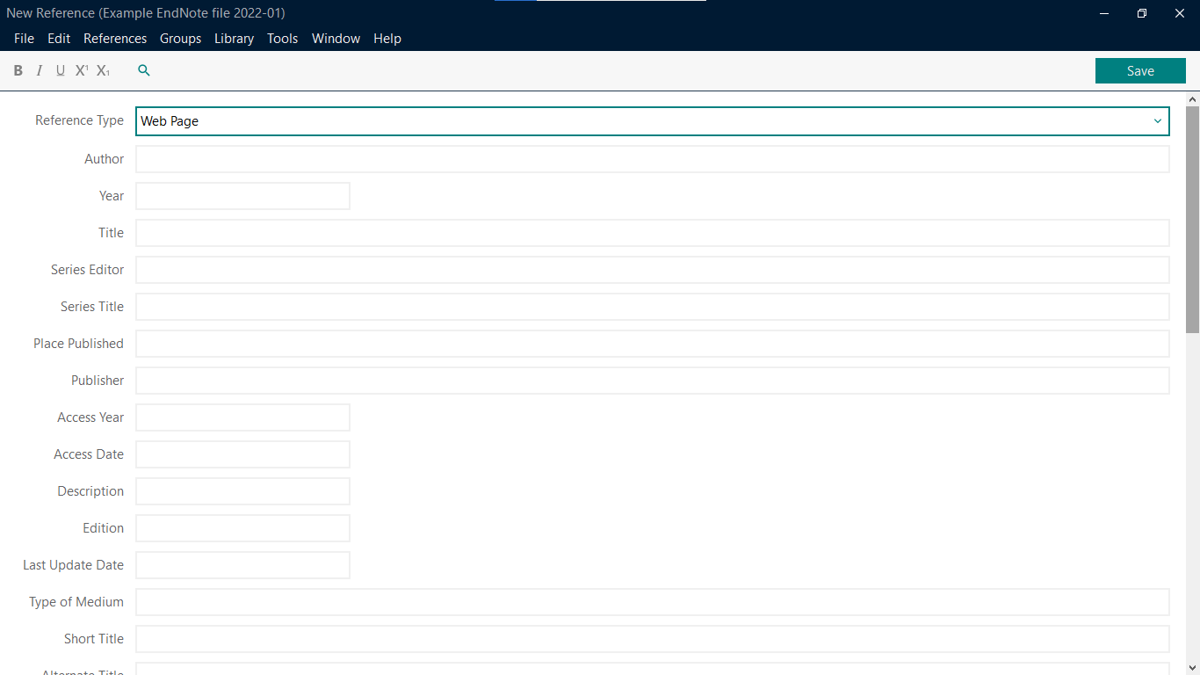
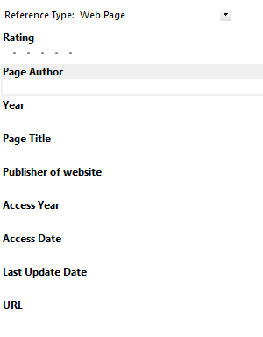

Slide 28
Other topics/ questions?
Possible extra topics
EndNote web/ synchronization
(brief advice: don’t use it)
Adapting import filters / output styles
Randomization of results from EndNote

